Slide 1
Hack the Future: A Gen AI Sprint Powered by Data

Slide 2
Theme
"Applications of AI Agents in the Real-World”
This theme explores how advanced artificial intelligence can be seamlessly integrated into practical, real-world scenarios to drive innovation and efficiency. It highlights the potential of AI agents to transform business processes, enhance decision-making, and optimize client services. From automating routine tasks to providing deep insights through data analysis, AI agents can empower consultants to deliver more strategic, data-driven solutions to address real-world challenges, such as improving operational efficiency, enhancing customer experiences, and driving sustainable growth.

Slide 3




Hack the Future: A Gen AI Sprint Powered by Data
Data and AI Week
Team details
TEAM NAME: SheCodes
Name (Team Leader) Meghana T B
Name : Meghana T B
Photo

Slide 4
Entry Submission Summary
Idea Title (Provide a concise and impactful title for your idea.) | AI-Powered Shopping Genie: Personalized E-Commerce at Scale
Team Name | SheCodes
Problem Statement | Smart Shopping: Data and AI for Personalized E-Commerce
Proposed Solution

Slide 5
Problem Statement (in detail)
Problem Statement : Smart Shopping: Data and AI for Personalized E-Commerce Challenge Overview:
In the competitive world of e-commerce, providing personalized and relevant product recommendations is key to improving customer experience, increasing conversion rates, and boosting sales.
In this challenge, your task is to build a multi-agentic AI system that delivers hyper-personalized product recommendations for an e-commerce platform. This system will utilize different agents representing customers, products, and recommendation engines, all collaborating to analyze browsing behavior, predict user preferences, and optimize the overall shopping experience. Your Data & AI system should enable the e-commerce platform to deliver tailored recommendations based on each customer's behavior and interests, ultimately improving engagement, increasing average order value, enhancing customer retention, and driving higher conversion rates.
Current Process:
Customer Data Collection and Segmentation: E-commerce teams manually collect and store customer browsing behavior, purchase history, and demographic data in databases or spreadsheets. Customer profiles are created based on specific attributes like age, gender, location, and purchase history, which are used to manually segment customers into different categories (e.g., frequent buyers, new visitors). Retail managers or marketing teams manually analyze the customer data to identify patterns, trends, and preferences, which can be used to make product recommendations.
Product Recommendations : Based on the customer profile and segmentation, the marketing team manually selects a set of products to recommend to each customer segment. For example, “frequent buyers” might receive recommendations of related products, while “new visitors” could see the most popular products or discounts.

Slide 6
Proposed Solution Overview
(Applicability of GenAI and agentic AI in the proposed solution)
In e-commerce, personalized product recommendations are essential for enhancing customer engagement, improving sales conversions, and increasing retention. Traditional recommendation methods rely on manual data collection and segmentation, which is inefficient and lacks real-time adaptability.
Solution Overview
The Smart Shopping AI System addresses these challenges by implementing a multi-agent AI framework that intelligently analyzes customer data and provides hyper-personalized recommendations.
Technologies Used
- SQLite for structured long-term customer and product storage
- Python for AI-based data processing and recommendations
- Flask or FastAPI (if needed) for web-based interactions
- JavaScript for dynamic user interfaces in the frontend
- Machine Learning Models for predictive recommendations (optional)
Key Features and Workflow
- Customer Agent: Tracks browsing history and purchase behavior
- Product Agent: Maintains product details, categories, popularity, and trends
- Recommendation Engine: Uses AI models and filtering techniques to suggest relevant products based on customer preferences
Expected Outcomes
- Improved shopping experience with personalized recommendations
- Higher conversion rates through relevant product suggestions
- Enhanced customer retention by offering engaging shopping experiences

Slide 7
Technologies Used
1. Backend and Data Management
- **Python** – The primary programming language used for scripting and AI-driven logic.
- **SQLite** – A lightweight, relational database system for managing customer and product data efficiently.
- **SQLite3 Library** – A Python module that provides direct interaction with the database for data storage and retrieval.
2. Interactivity and User Input
- **Command Line Interface (CLI)** – Enables users to interact with the system through terminal-based prompts, suitable for basic testing and execution.
- **Python's `input()` Function** – Facilitates real-time user input, allowing customers and products to be added dynamically.
3. Recommendation Engine and AI Concepts
- **Content-Based Filtering** – Uses customer browsing history to match relevant products, ensuring personalized recommendations.
- **Sorting and Popularity Score** – Organizes suggested products based on popularity and demand metrics to optimize recommendations.
- **Dynamic Data Handling** – Retrieves user preferences and adapts recommendations instantly based on stored data.
4. Scalability and Future Enhancements
- **Flask or FastAPI (Optional Upgrade)** – Can be implemented to provide a web-based interface, allowing real-time API interactions.
- **Machine Learning Algorithms** – Enhancing the recommendation engine with predictive analytics using collaborative filtering techniques.
- **Cloud Storage (Optional for Deployment)** – Platforms such as AWS, Firebase, or Google Cloud can be used for handling larger datasets and enabling remote access.
This technology stack ensures scalability, efficiency, and seamless integration with modern AI-powered e-commerce.

Slide 8
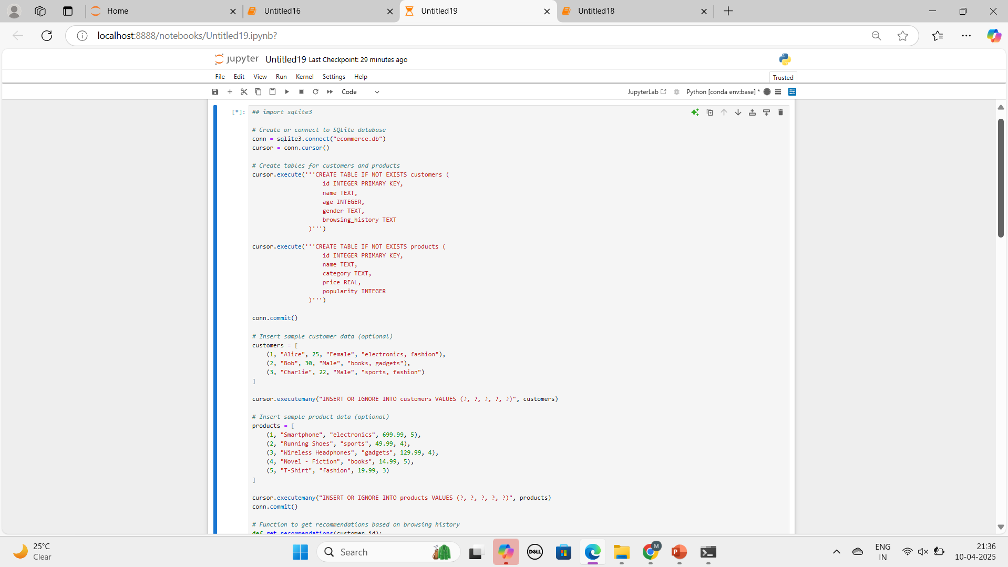

Slide 9
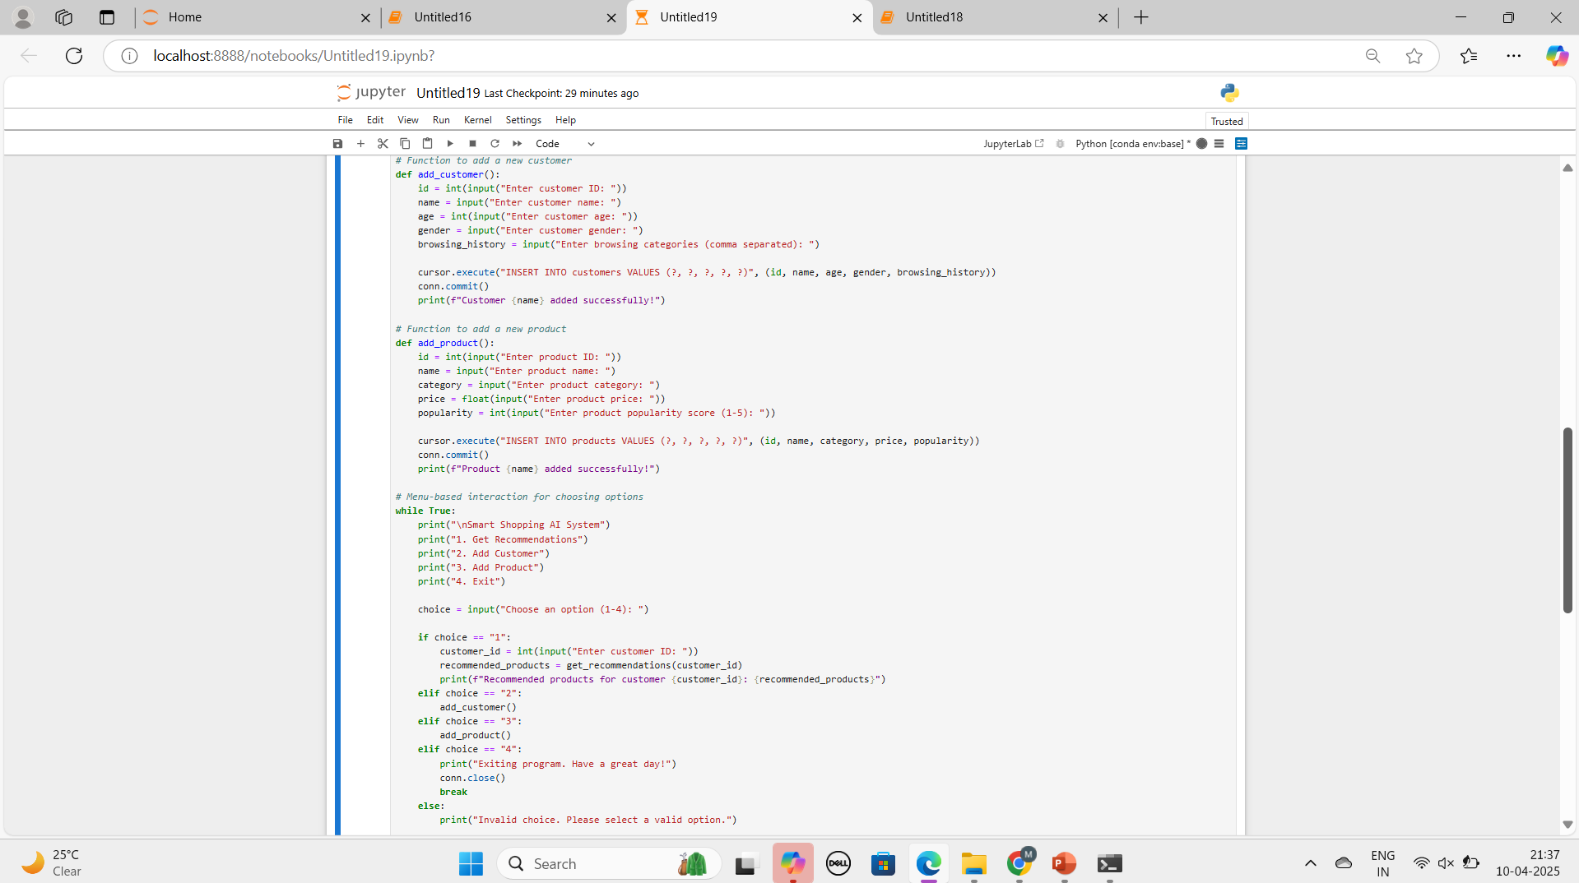

Slide 10
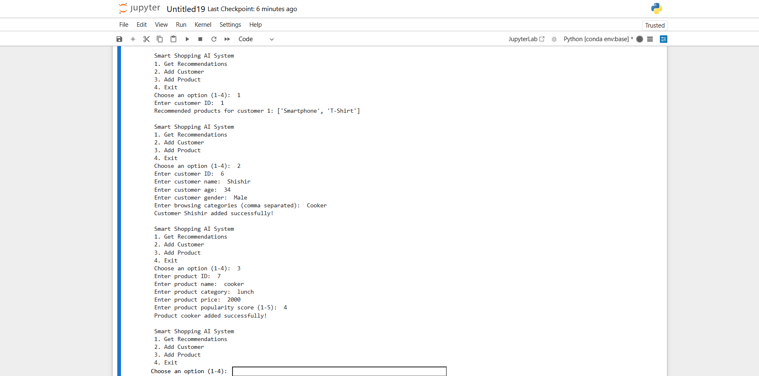

Slide 11
Conclusion
The **Smart Shopping AI System** leverages modern data analytics and AI-driven recommendation techniques to transform e-commerce personalization. By integrating a structured multi-agent framework, it enhances product discovery and improves customer engagement. The system efficiently processes user browsing history, purchase patterns, and product trends using SQLite for data storage and Python-based recommendation logic. Scalability options such as Flask/FastAPI for API integration and potential machine learning models ensure adaptability for more advanced personalization strategies. With future enhancements, such as cloud deployment and AI-based predictive modeling, the system can provide **hyper-personalized shopping experiences** that drive higher conversion rates and customer retention. This solution ultimately aligns with the evolving demands of modern e-commerce, ensuring businesses remain competitive while delivering tailored shopping experiences to users.
.

Slide 12

Thank You

